Slide 1
Assignment 3 Aerial/Satellite Imagery Retrieval
Vatsal Patel (A20458061)
Quick Savajiyani (A20451378)
Aditi Desai (A20444864)

Slide 2
Overview
Here in this assignment we are supposed to automatically download aerial imagery (maximum resolution available) using the latitude/longitude bounding box and Bing Maps Tile System.
We are also supposed stitch all the individual images to get the final resulting satellite image.
Input latitudes, longitudes: lat1, lon1, lat2, lon2 and Output is a satellite image.

Slide 3
Development Environment / Resource
Development Environment
Python 3.7
NumPy
Bing Map Tile System
Urllib
Resources Used
Bing Maps Tile System https://docs.microsoft.com/en-us/bingmaps/articles/bing-maps-tile-system

Slide 4
Introduction
Satellite imagery offers a huge amount of useful information in many specific domains including cartography, meteorology, geology, environment sciences or archeology.
Techniques which can be used for Satellite image retrieval are:
Content-based image retrieval .
Modified Block Truncation Coding.
Pattern Generation For Texture.

Slide 5
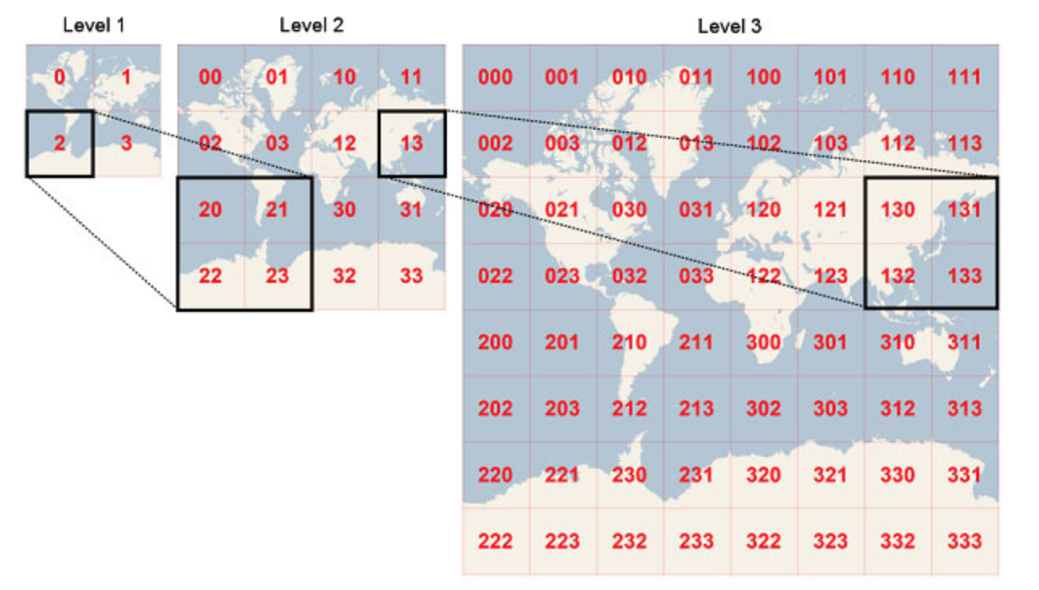
Bing Maps Tile System
‘Bing Maps’ maps the world using satellite images stitched together. As you can appreciate, these are terabytes of data we are talking about in the map processing.
To optimize performance these images are divided into tiles of 256×256 pixels each.
Bing Maps has the concept of zoom levels. There are 23 zoom levels where 1 displays the whole earth and 23 zooms at street level. When you zoom in or out at a different zoom level, different tiles (and hence satellite images) are displayed.
Tiles have their own coordinate system (a “Tile XY coordinate”) which can also be denoted as a single string called a ’quad key’.
t’s a conformal projection, which means that it preserves the shape of relatively small objects. This is especially important when showing aerial imagery, because we want to avoid distorting the shape of buildings. Square buildings should appear square, not rectangular.
It’s a cylindrical projection, which means that north and south are always straight up and down, and west and east are always straight left and right.

Slide 6
Outline
Take the latitude/longitude coordinates (in degrees) as the input and convert it into pixel XY coordinates for a specified map size.
Convert pixel XY coordinates into tile XY coordinates of the tile containing the specified pixel.
Validate the tile values for X and Y coordinates. Proximity of points i.e. must not lie on the same tile.
Transform tiles into main diagonal form for convenience. Determine the bounding tiles with highest level of detail.
Converts tiles XY into a Quad Key and then download the images corresponding to the Quad Key save the bounding image names using hash function and stitch these images based on it.
The stitched final image is then saved.

Slide 7
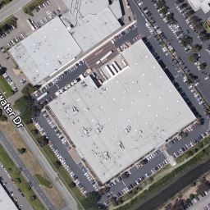
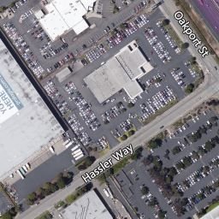
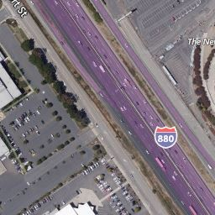
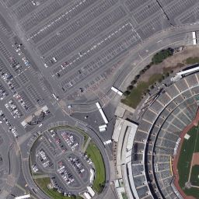

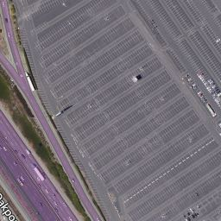
Images to be stitched

Slide 8
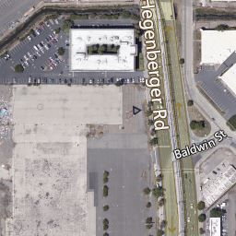
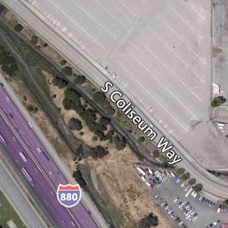
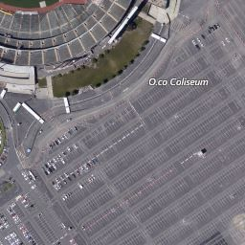
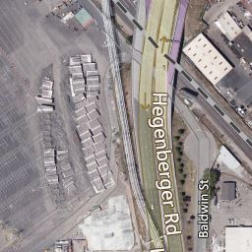
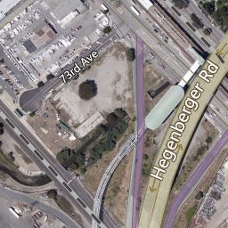
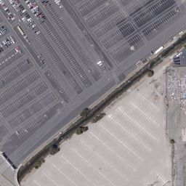
Images to be stitched

Slide 9
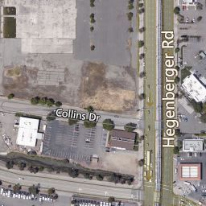
Images to be stitched

Slide 10
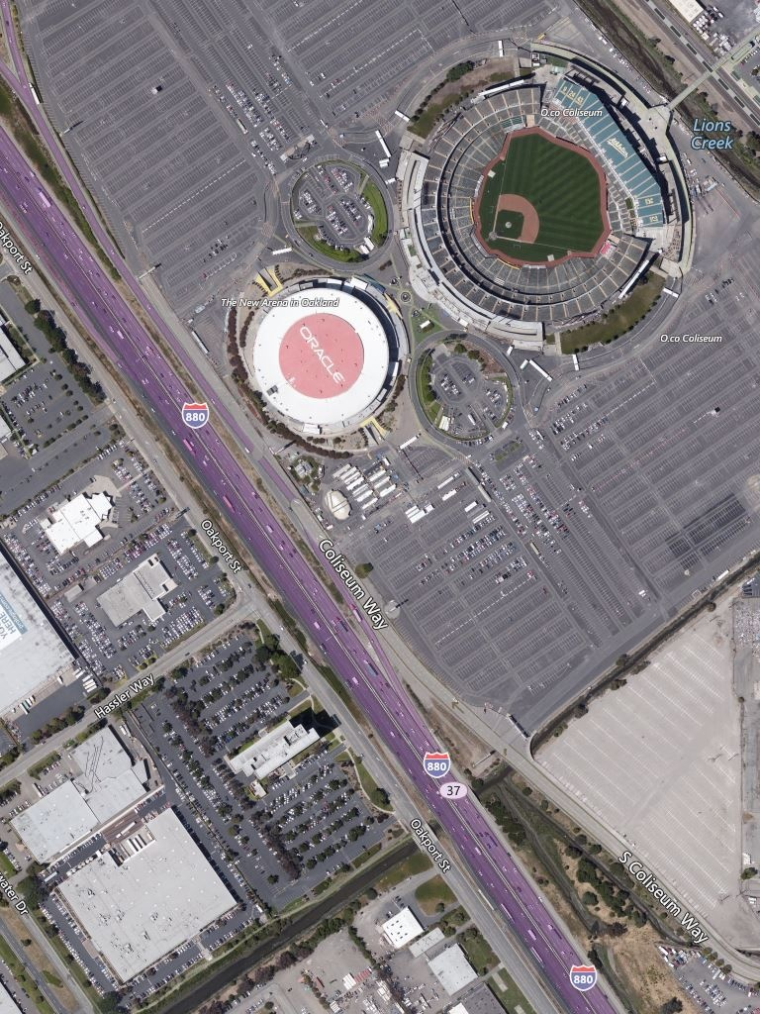
Final Image

Slide 11
Result
In the assignment we have attached a python file with the instructions to run the code in Readme file.
There are two files.
First file contains the source code for retrieving satellite images based on the coordinates
Second file contains the output images of the tested latitude and longitude.

Slide 12
References
https://msdn.microsoft.com/en-us/library/bb259689.aspx
Bing Maps Tile System https://docs.microsoft.com/en-us/bingmaps/articles/bing-maps-tile-system

Slide 13
Thank You

